Slide 1
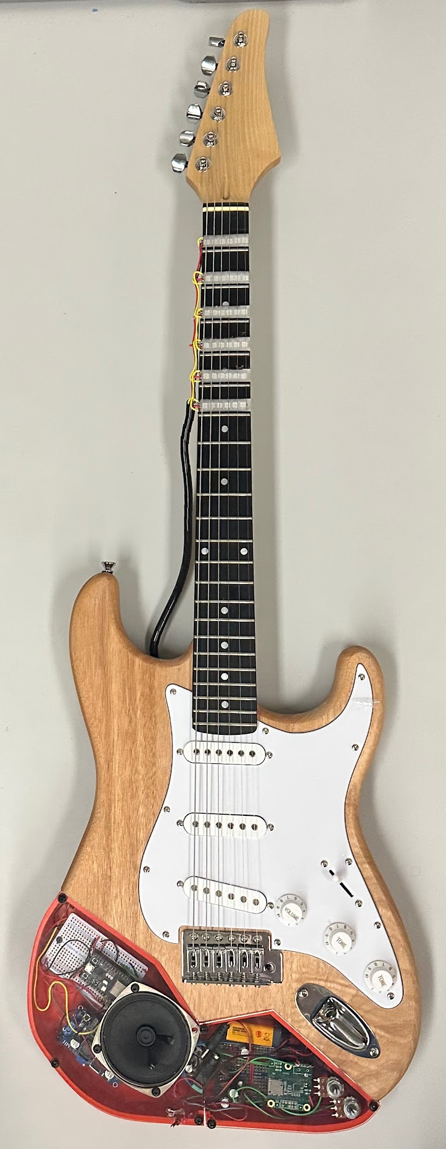
StrumTech; Innovative Guitar System for Beginners
David Ellis; Digital Effects, Circuitry and Guitar Body
Austin Petersen; PCB, 3D Print Designs and Guitar Body/Neck
Gerald Stanford; App, Coding and Testing
Michael Ward; Coding, Circuitry and Guitar Body/Neck

Slide 2
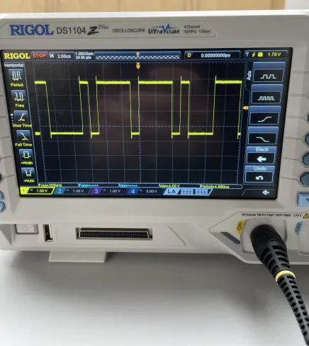
Engineering Standards and Codes
Analog Input Signal
ADC
ISO/IEC 14882; C++ Coding Standard
ISO 16:1975; A440 Hz Standard
I2S Communication Specification
Bluetooth BLE Specification
JSON ECMA-404 Specification
I2S
MCU
I2S
DAC
Analog Output Signal
Notes:
I2S is a three-wire communication standard for transmitting digital sound signals
Like I2C it involves one controller and multiple targets
The three wires are:
Serial Clock
Serial Data
Word Select (L/R Clock)

Slide 3
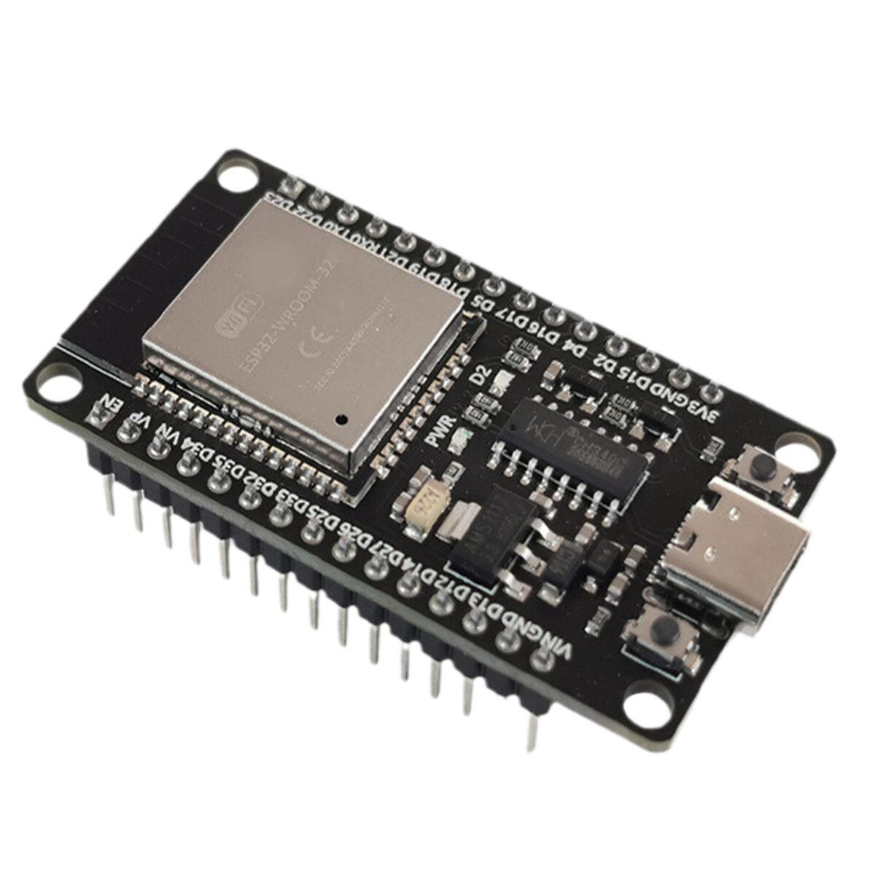
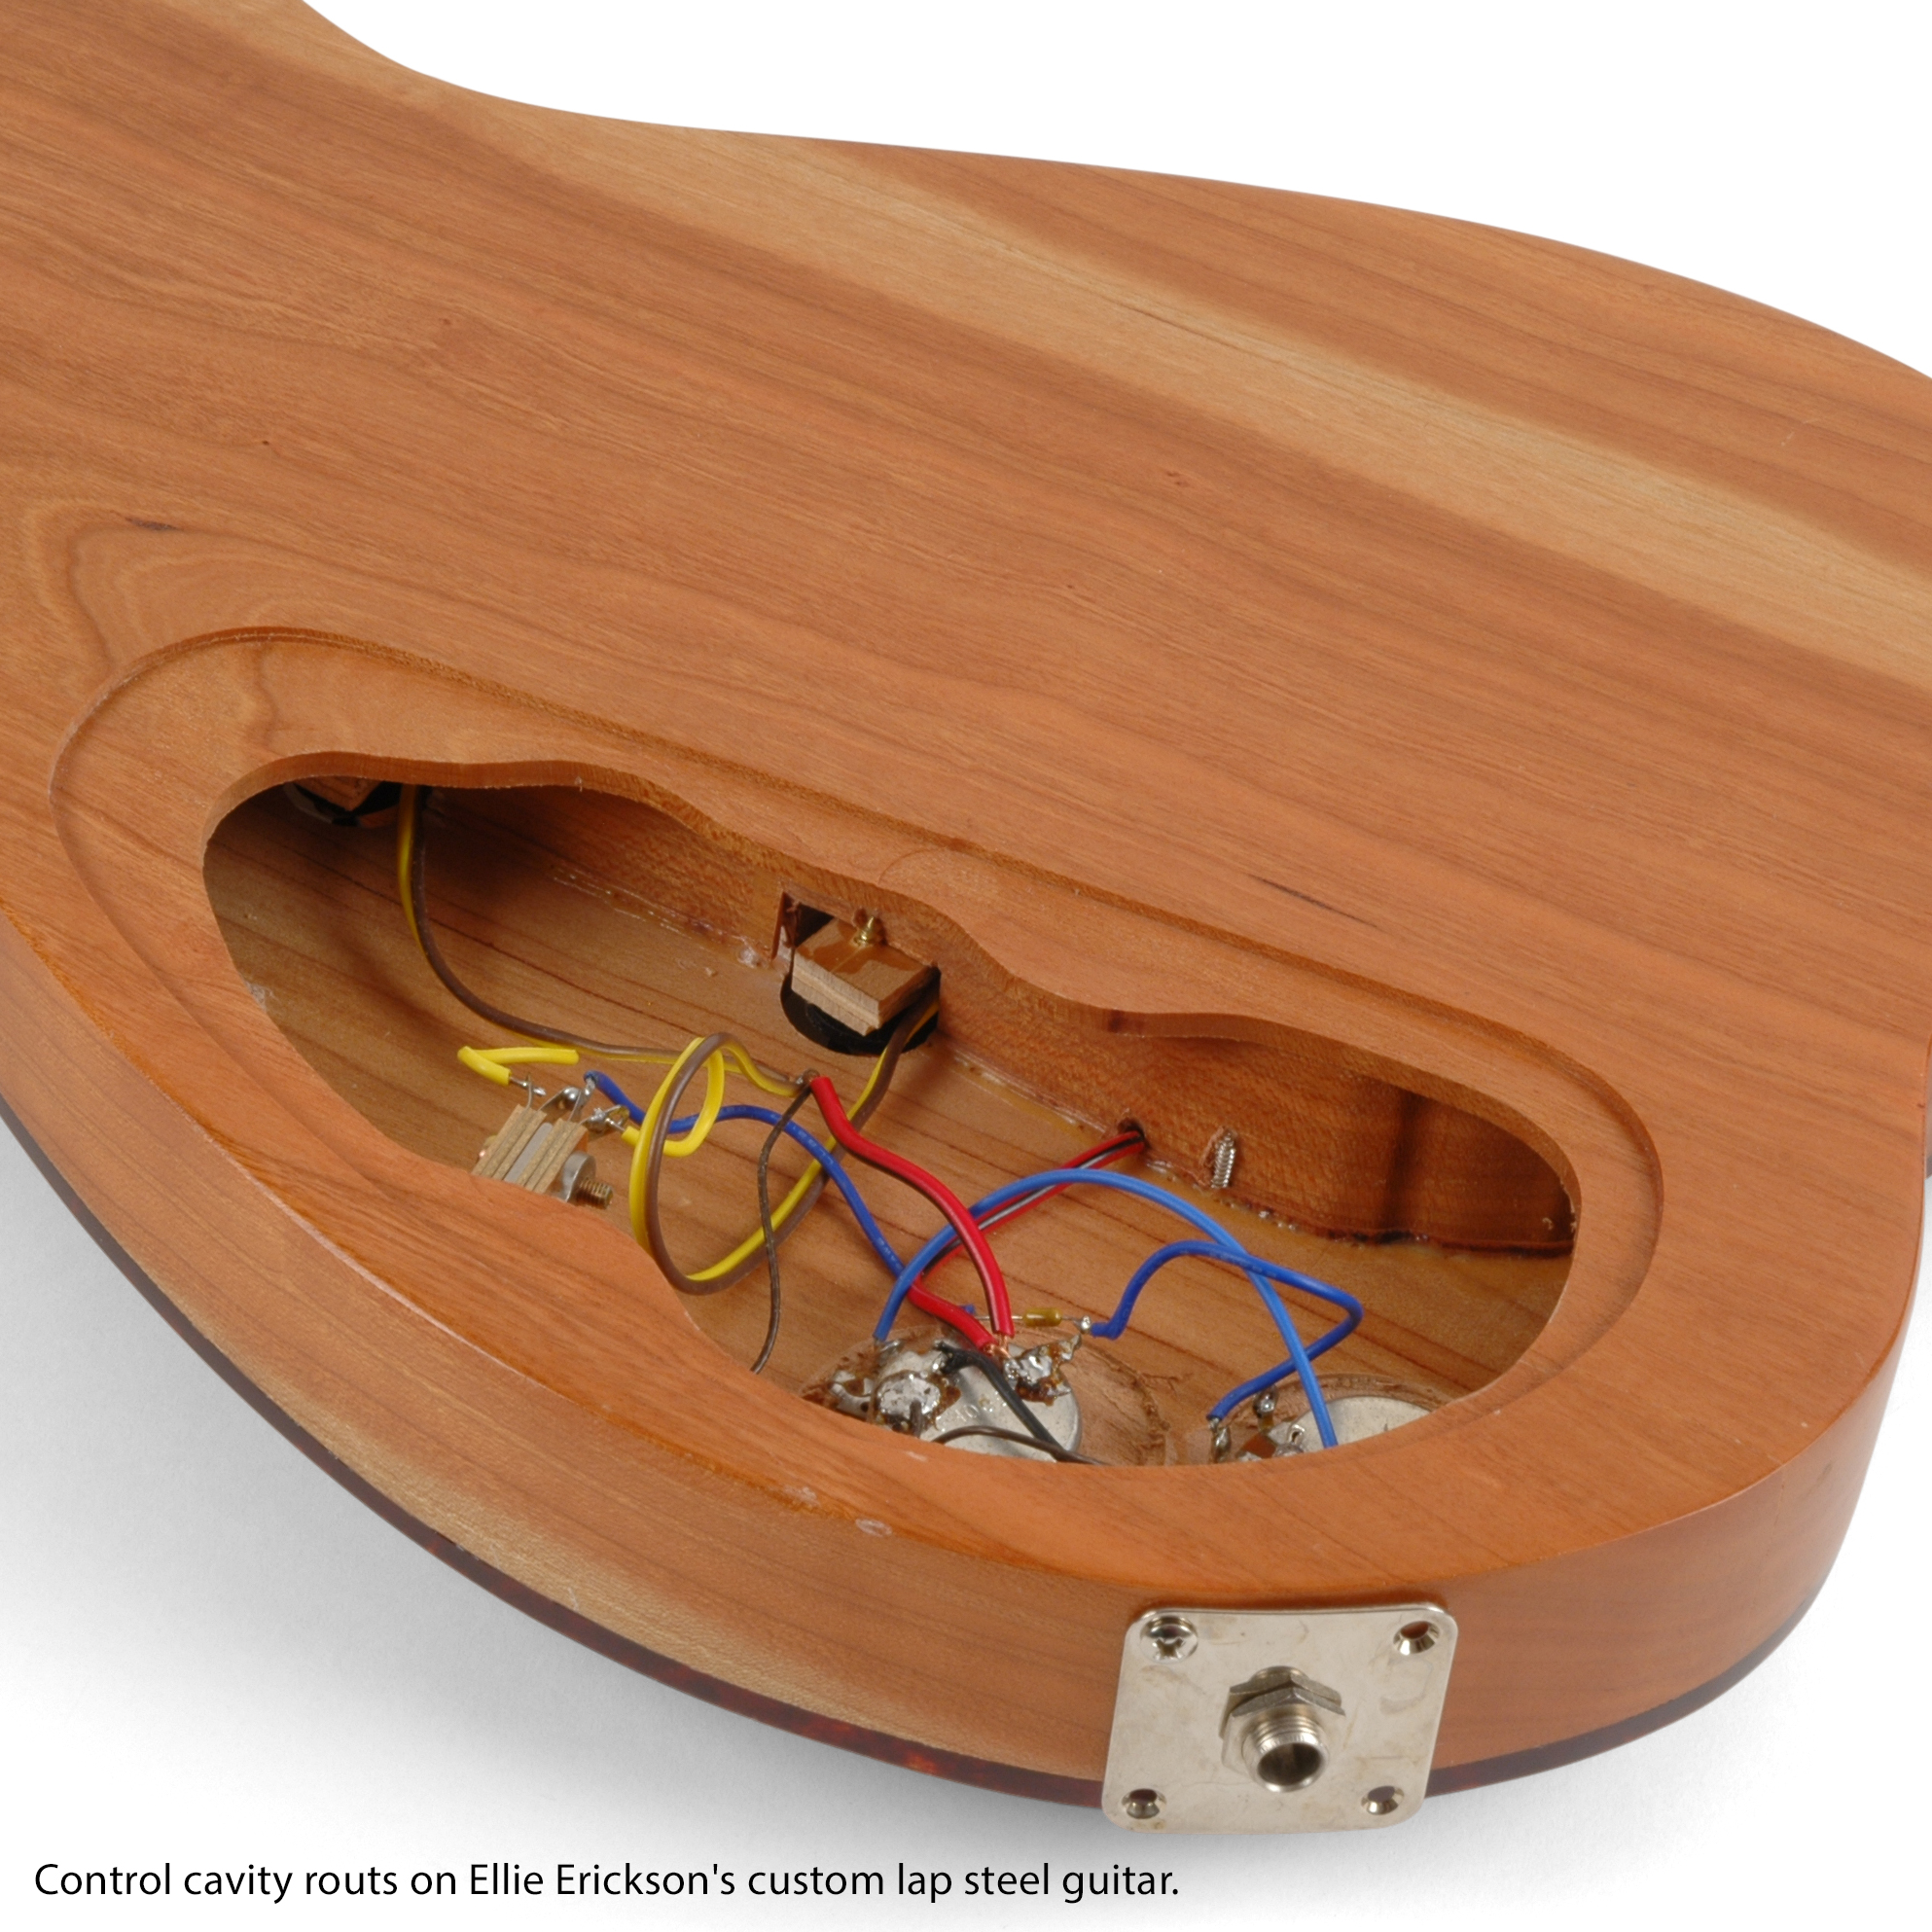
Constraints
Size of Guitar
Cost $
Processing Power
  Light array
  DSP
  Tuner
  Bluetooth
Speed/Latency
Time
Apple dev Ecosystem
  Cost
  Testability
$250 Budget

Slide 4
State of Project from Fall
Completed | To be Completed
Code for Tuner | Code for Digital Effects
Code for LED Fretboard | Guitar Body
Amplifier Circuit | Finalized LED Fretboard
Basic LED Fretboard | Bluetooth Connectivity
Start of App | Finalized App

Slide 5
Initial Game-plan for the Spring
For the spring semester, our goals were to complete the app and insert the physical components into the guitar. Our specific goals were as follows:
Complete Phone App, including
  Tuner Interface
  Digital Pedal Interface
  Chord Interface
Change PCB design to repair connection issues
Build Guitar and Insert Components into Guitar and Fretboard
Complete Digital Effects component and receive proper sound from it

Slide 6
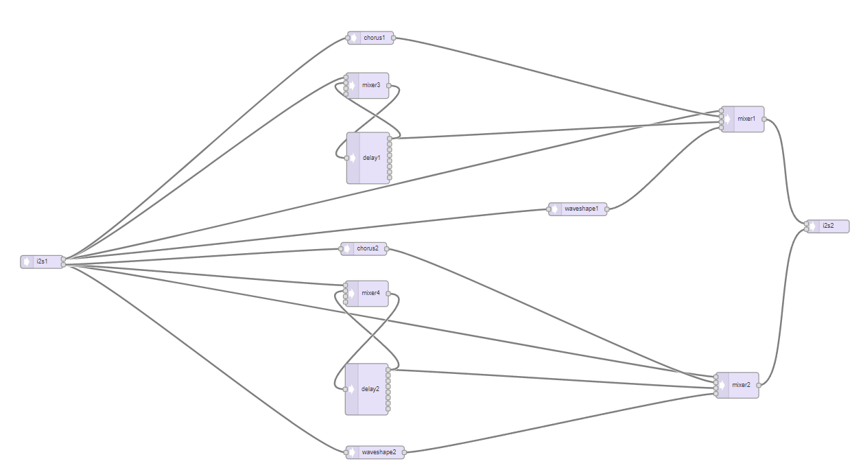
Implementation of Digital Effects
Teensy audio adapter board and audio library
Built in ADC and DAC
Attempted to implement delay, chorus, and distortion
Resulting effects were delay and “techno-distortion”

Slide 7
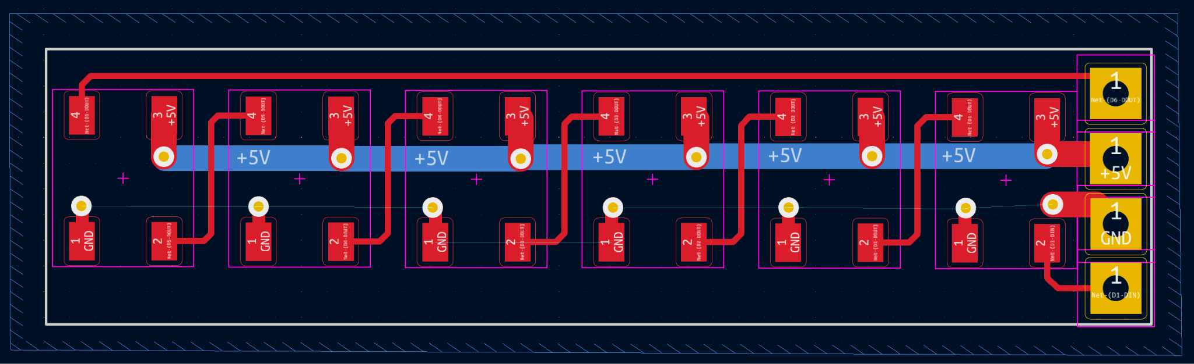
New PCB and Construction of the LED Fretboard
Due to connection errors in our Fall PCB design, we changed our PCB to have through-hole soldering.
We cut channels into the fretboard to allow the insertion of the PCB into the neck.
We 3D printed translucent covers for the LEDs.
We then epoxied the PCBs onto the fretboard and hot glued the translucent covers onto them.
New PCB Design with Through-Hole

Slide 8
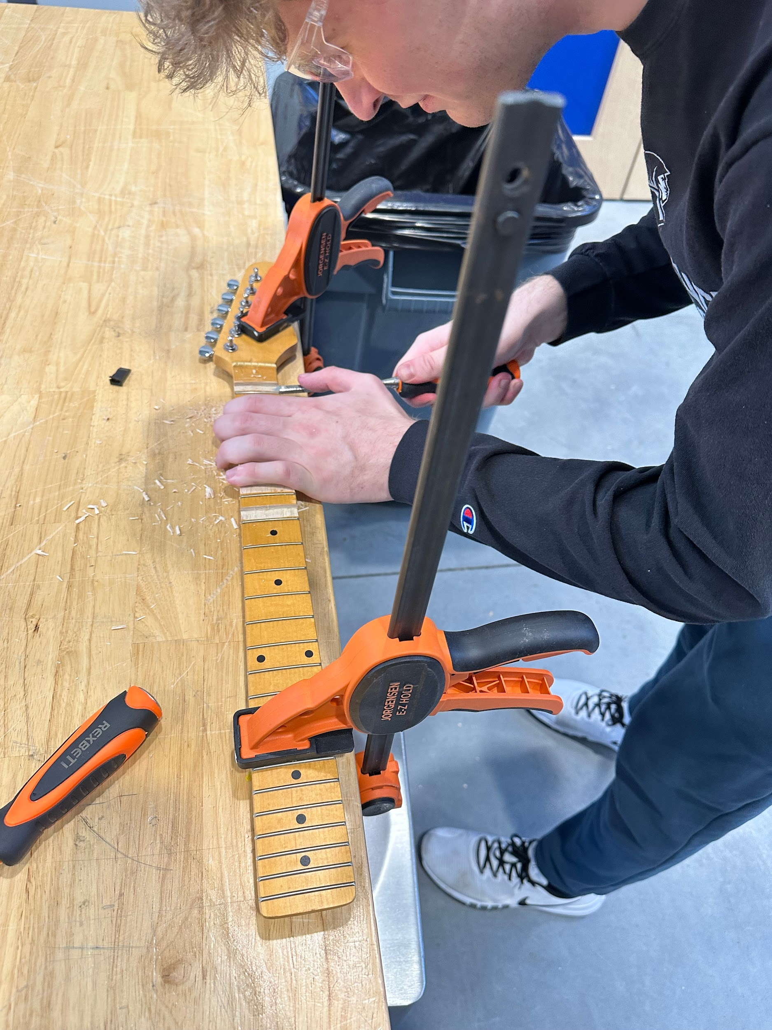
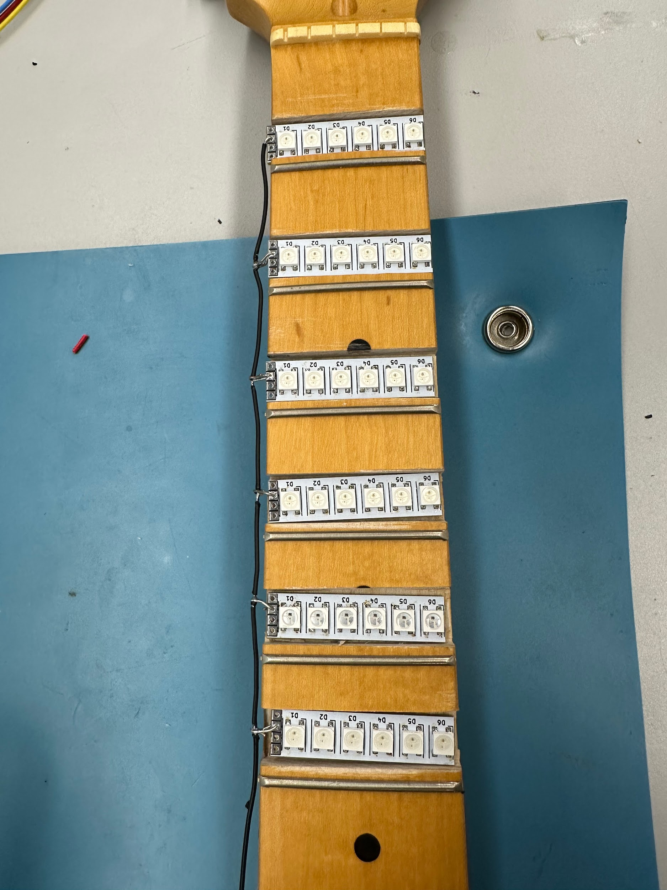
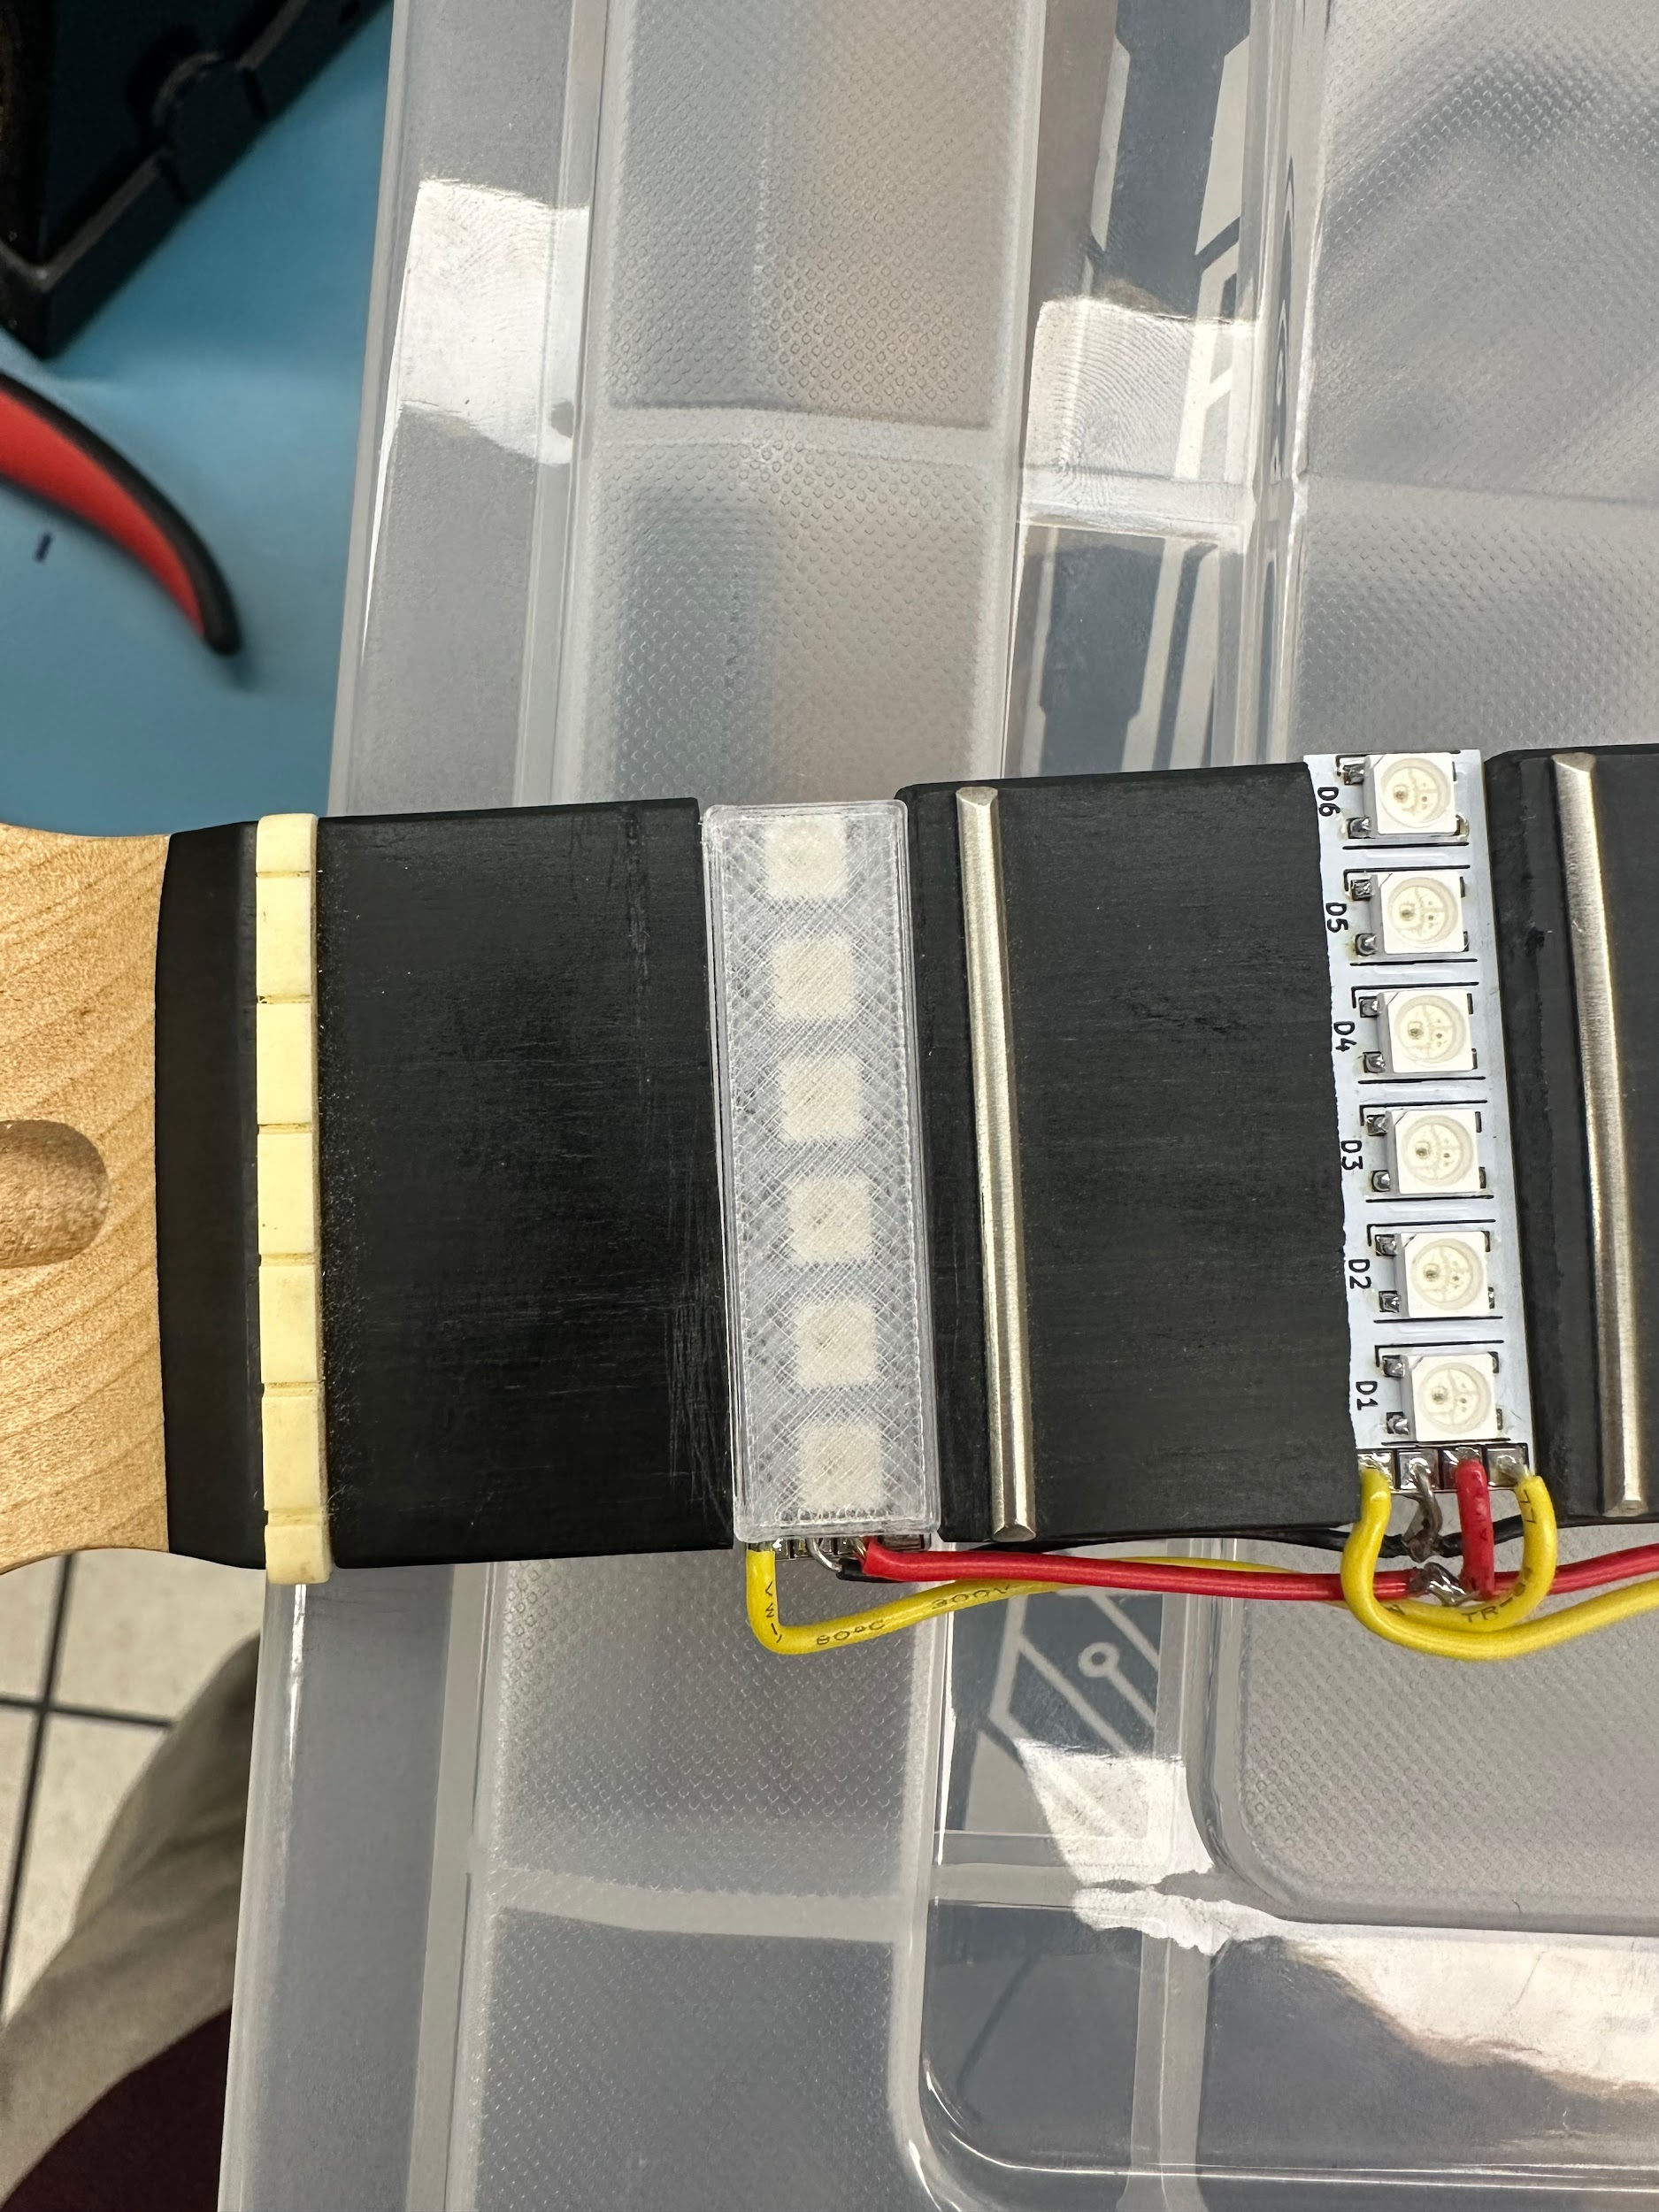
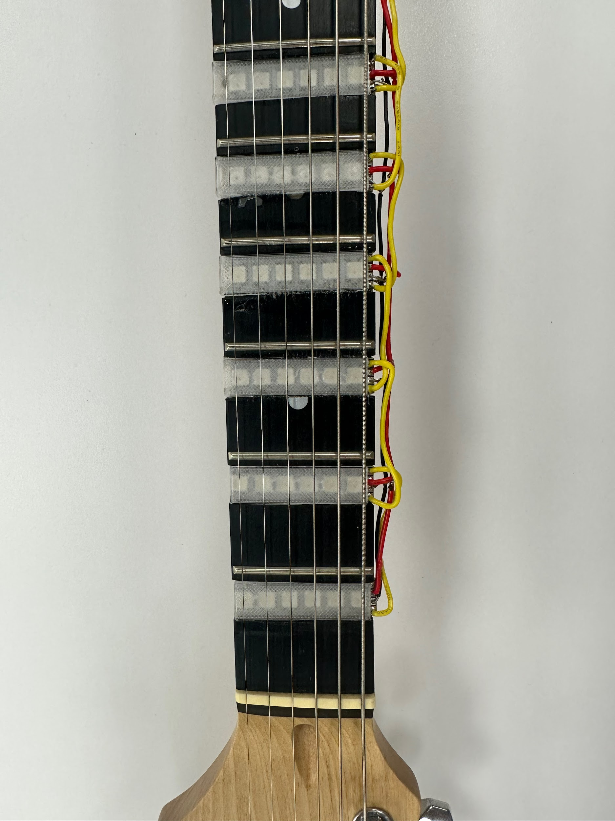
New PCB and Construction of the LED Fretboard
Cutting Channels in the Fretboard
Preliminary LED Strip Placement and Soldering
Translucent Cover for the LED Strips
Finalized LED Fretboard

Slide 9
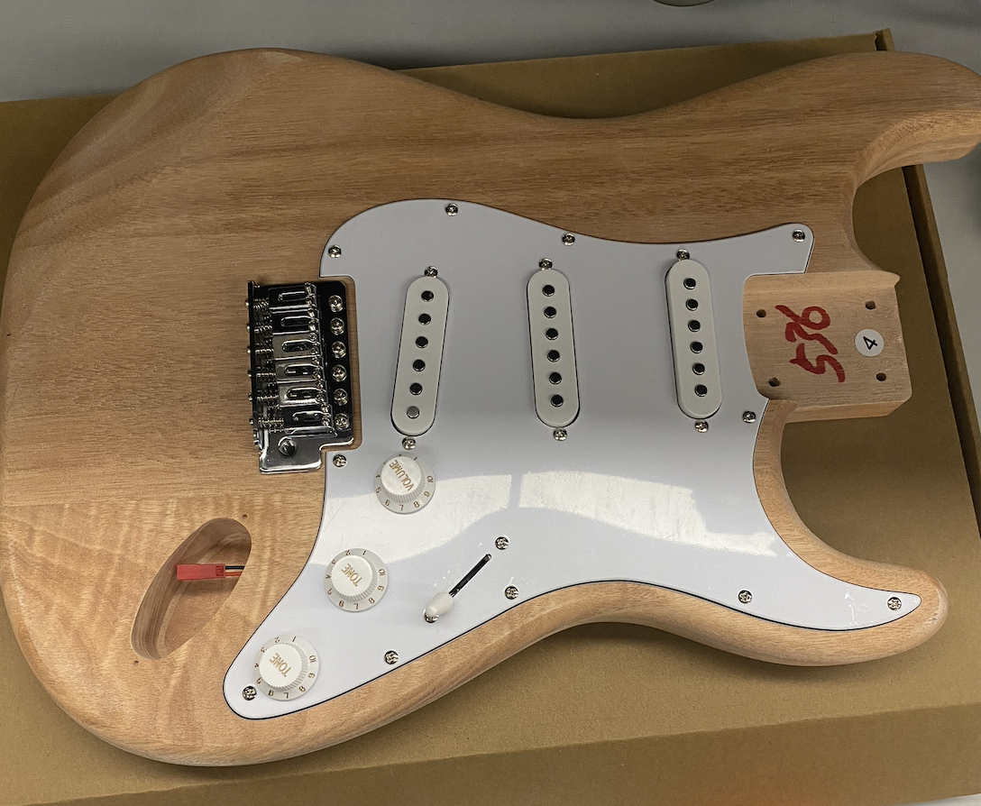
Design of Guitar Body
After receiving our guitar kit, we determined that there wouldn’t be enough space within the wood to insert all of our electronics.
We opted for designing a 3D print cavity and cutting off part of the guitar to insert this cavity.
We also decided to have any acrylic cover of the cavity to allow the viewing of all of the internal components.
Initial Guitar Body from Guitar Kit

Slide 10
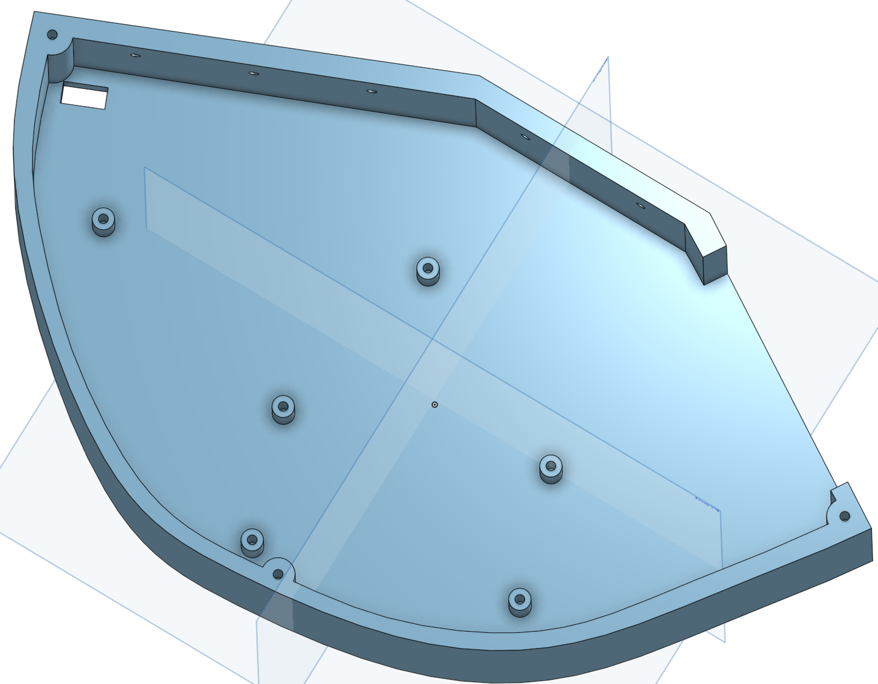
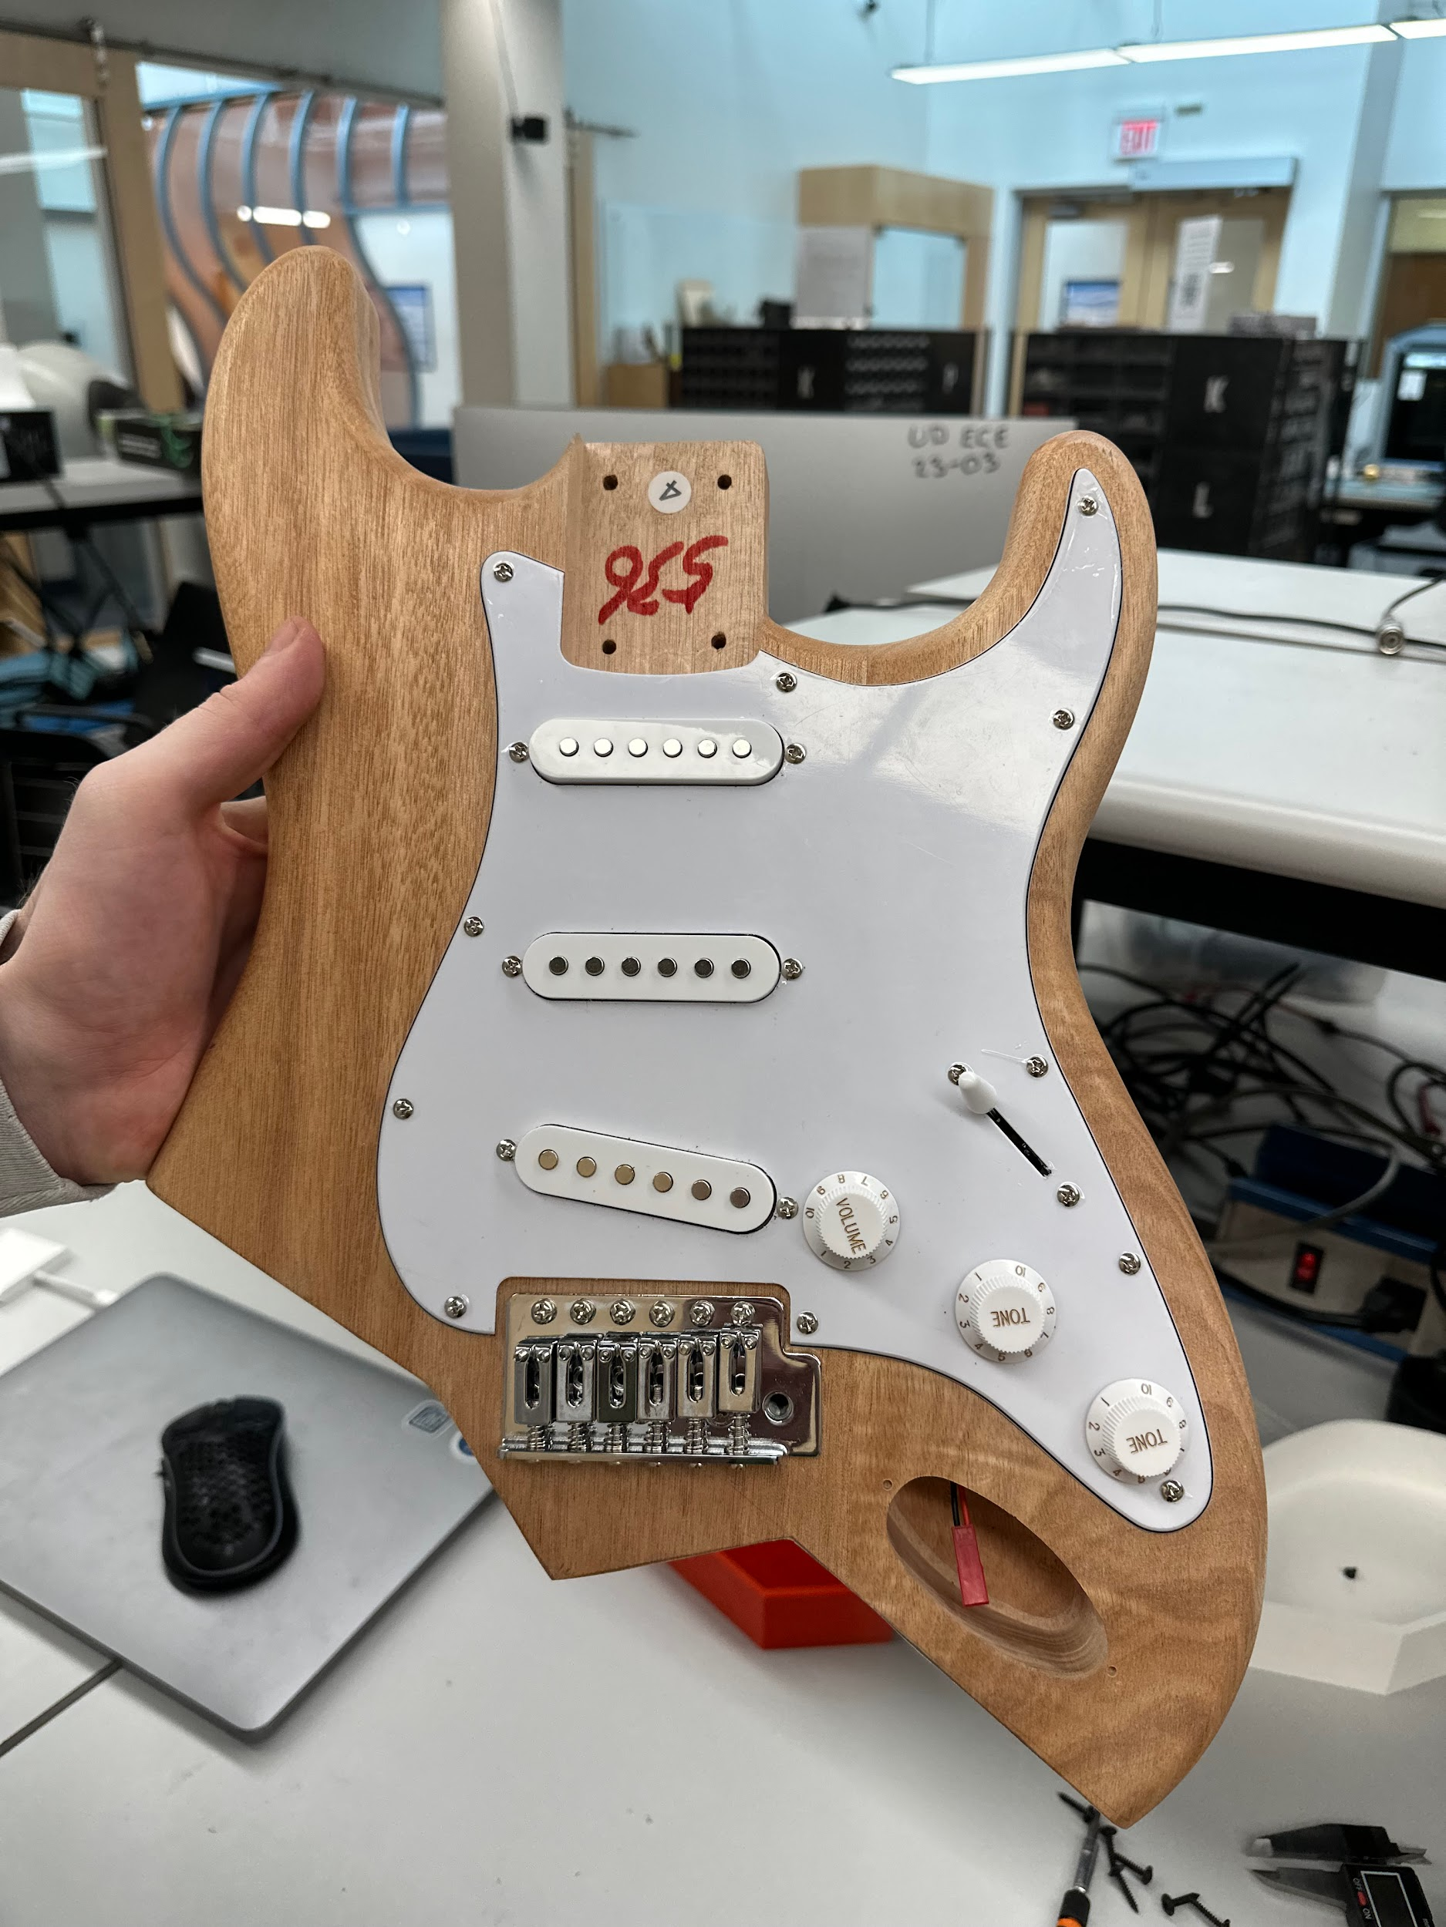
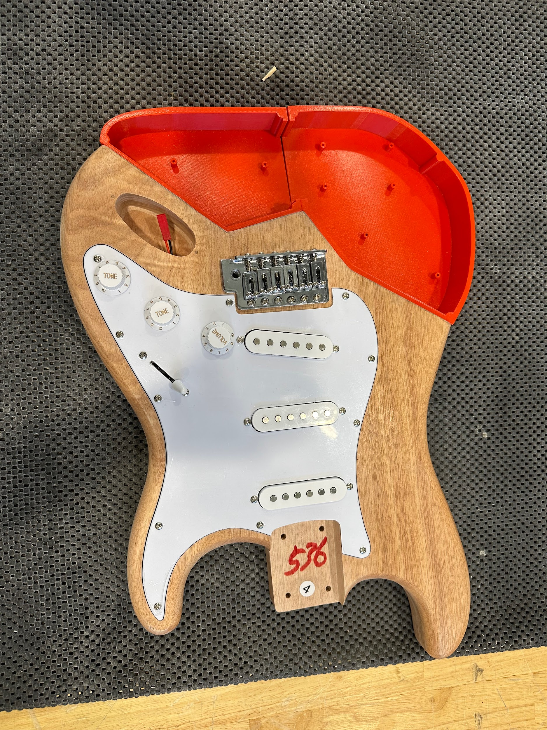
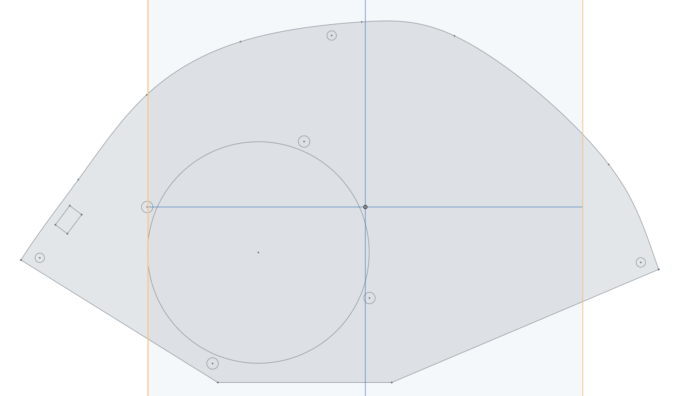
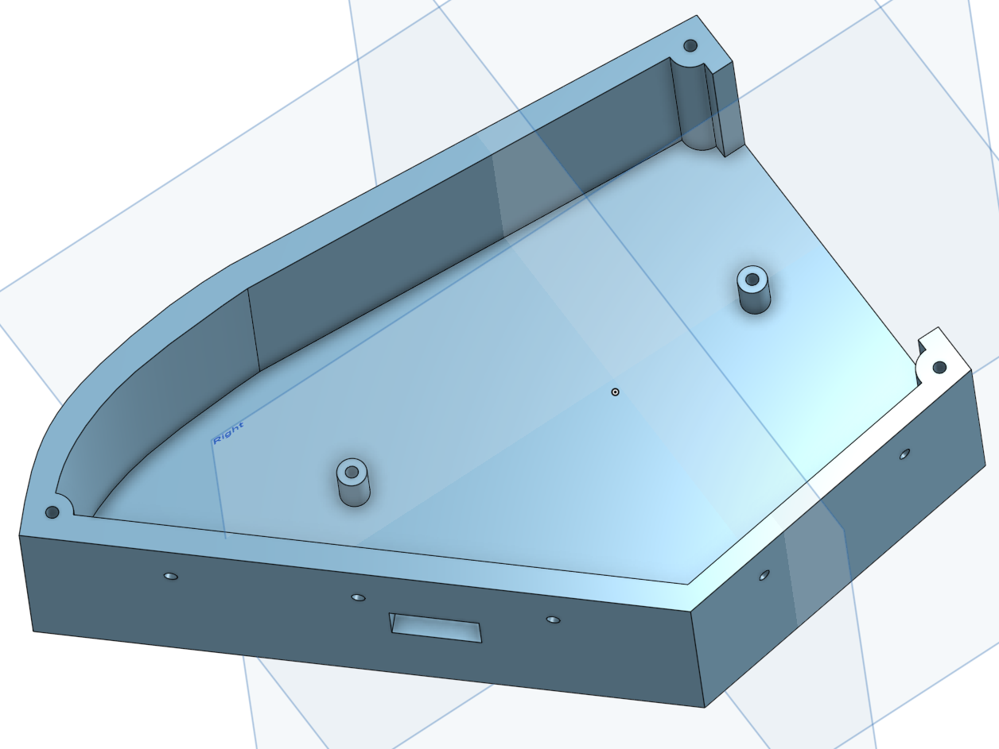
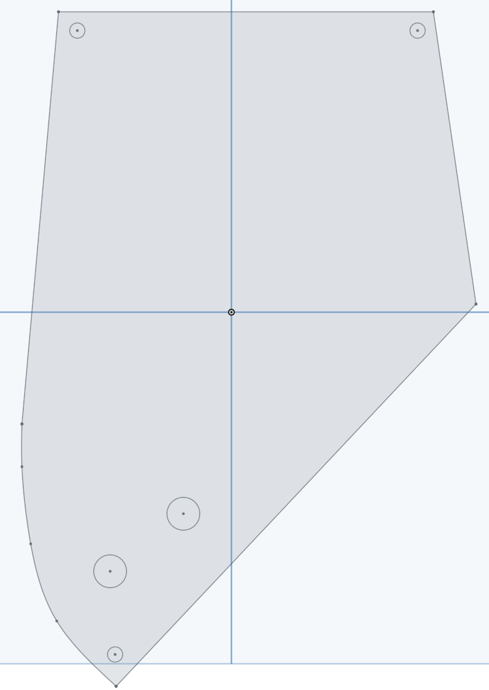
Design of Guitar Body
CAD Design for the Guitar Cavity
CAD Design for Acrylic Cover
Guitar Body with Cavity Space Cutoff
Finalized Guitar Body with 3D Printed Cavity

Slide 11
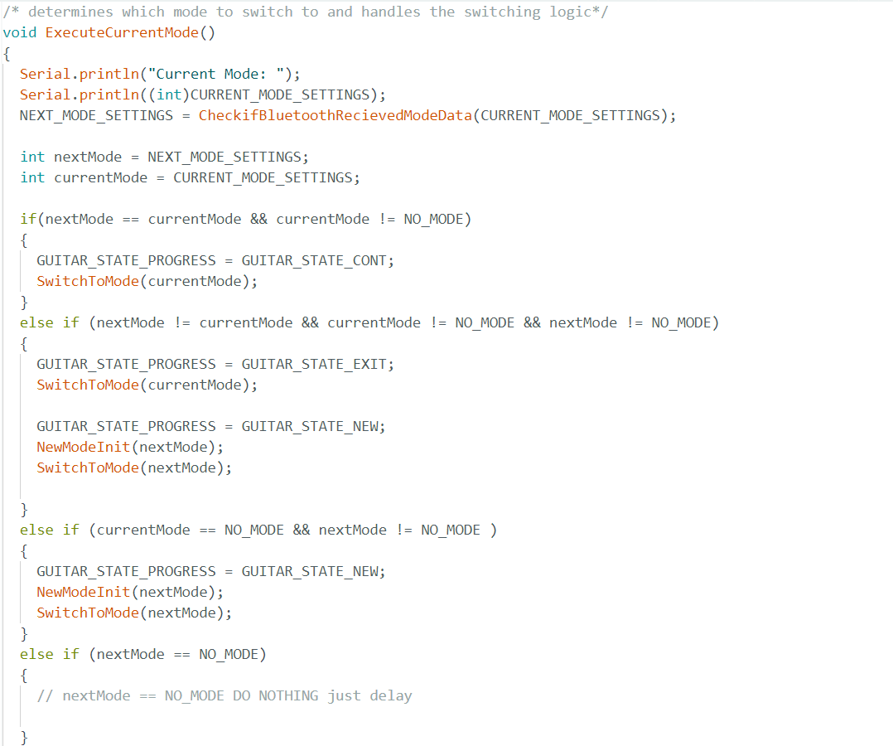
App Coding and Design
State Machine of the MicroController.

Slide 12
App Coding and Design
MICROCONTROLLER:
State machine
Switches through the different modes: Free play, Tuner, Chords
Each mode has 3 states: New, Cont’d, exit
Different capabilities of the learning guitar system are brought together here
Bluetooth configuration data
Services - encompasses groups of data (organization)
Characteristics - different data sent
Bluetooth communications / advertising

Slide 13
App Coding and Design
APP:
User Interface:
Chord selection Screen
Tuner Screen
Digital Effects Screen
Bluetooth Communication:
Send data to the controller to alter state and Receive data to display
Mode Control:
Change between the different guitar modes available on the controller by navigating between the different screens

Slide 14
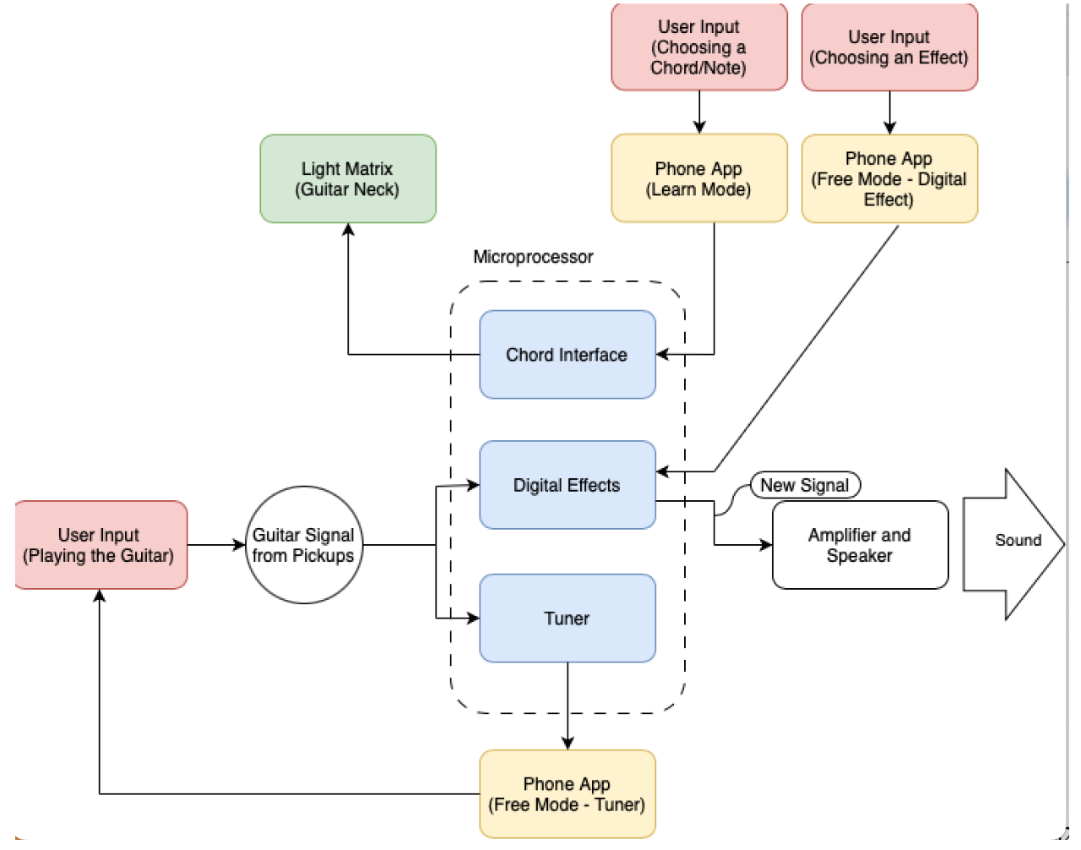
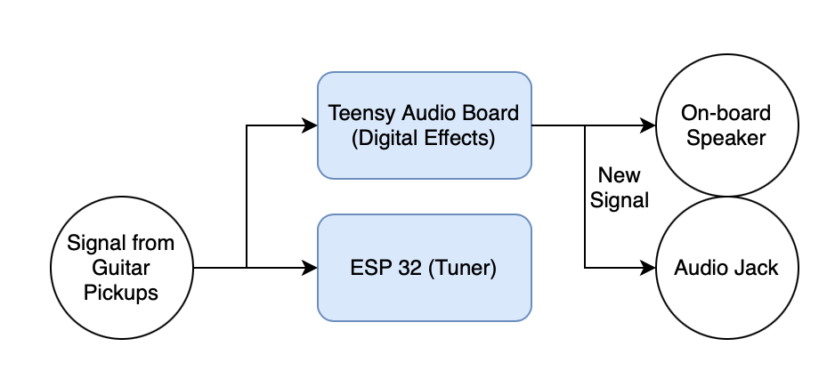
Circuit and Block Diagram
System Block Diagram
Audio Signal Circuit Diagram

Slide 15
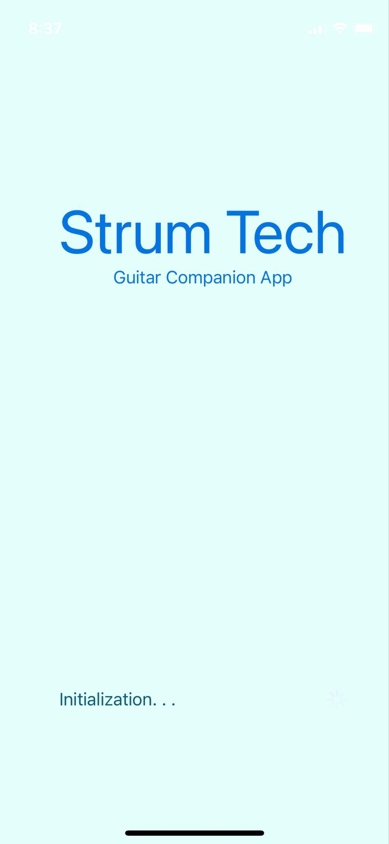
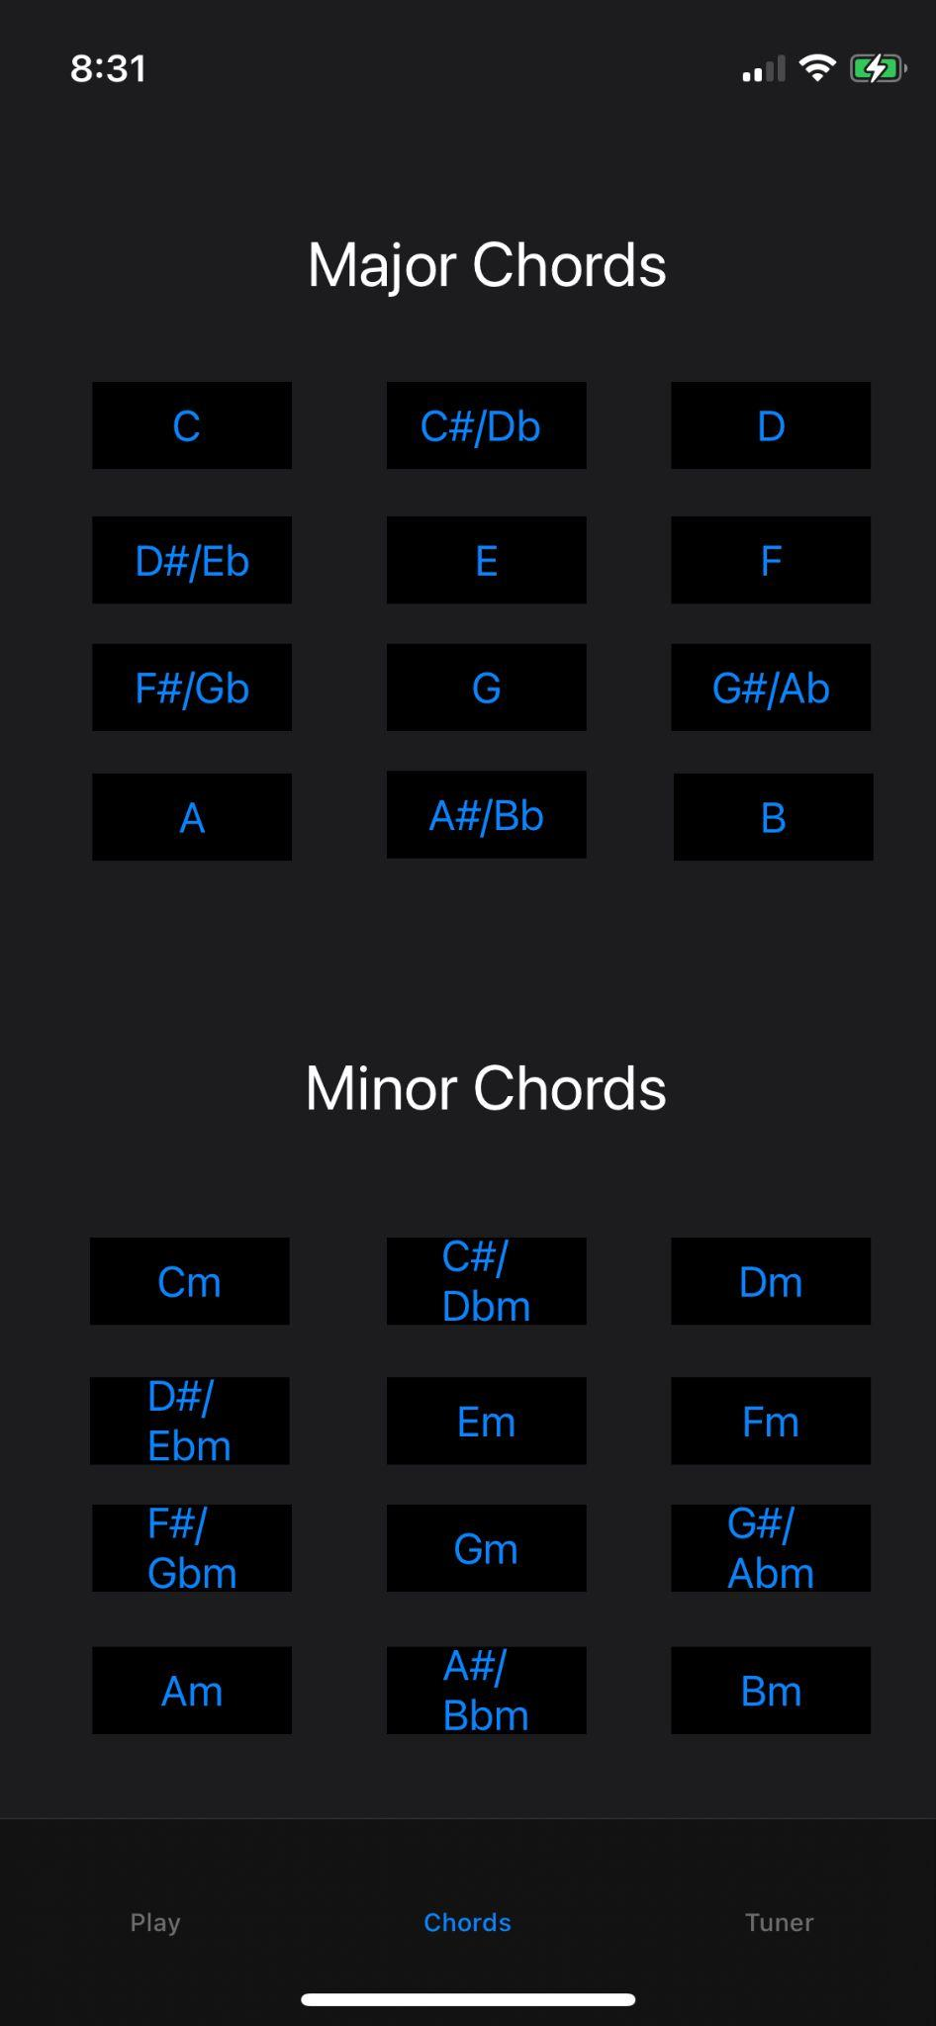
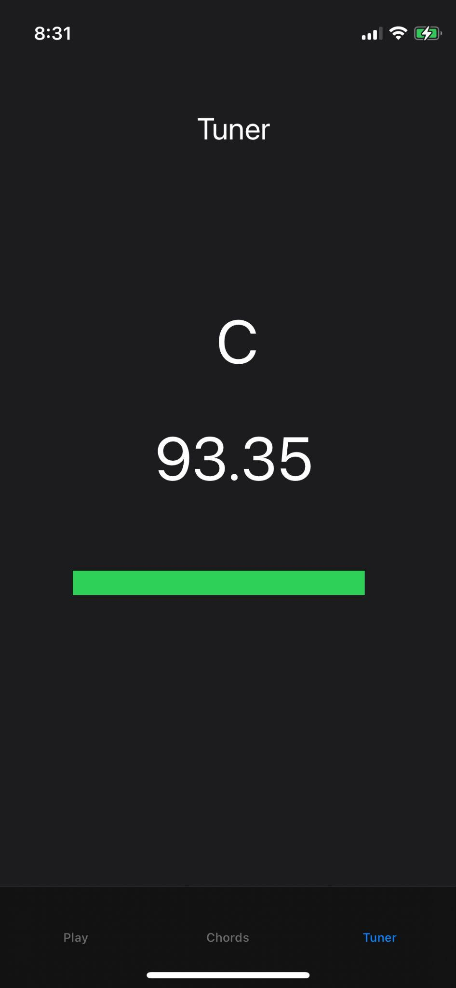
Demonstration

Slide 16
Challenges
Physical Space to Implement Circuitry was Small; drove us to try wall power instead of Lipo battery; wall power generated too much noise over speaker
Weird ESP32 Errors (Exit status 2)
Hard to hide wires for LEDs without lowering structural integrity of the neck
Amplifier attached to guitar would create a feedback loop causing the sound to continuously ring and get louder
Clear 3D print for LEDs can blend the colors together to make it a little harder to see where or what finger needs to be placed on the light

Slide 17
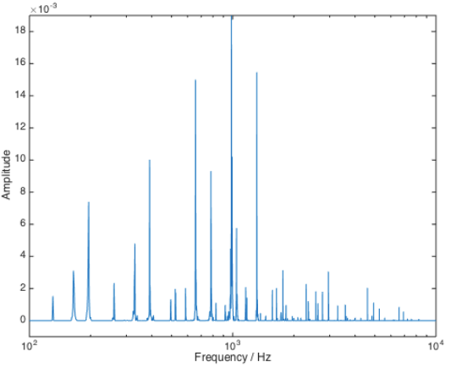
Desired Improvements
Low Pass filter on analog signals from ESP32 to Teensy to eliminate PWM noise and control all digital effect parameters from the app
Improve tuner code to consistently show the correct frequency and note
Implement note and chord detection
Add a song library with chords and melodies
https://pages.cs.wisc.edu/~kma/downloads/chord-recognition.pdf

